Slide 1
Samples collection
ا.د.رنا عدنان فائز

Slide 2

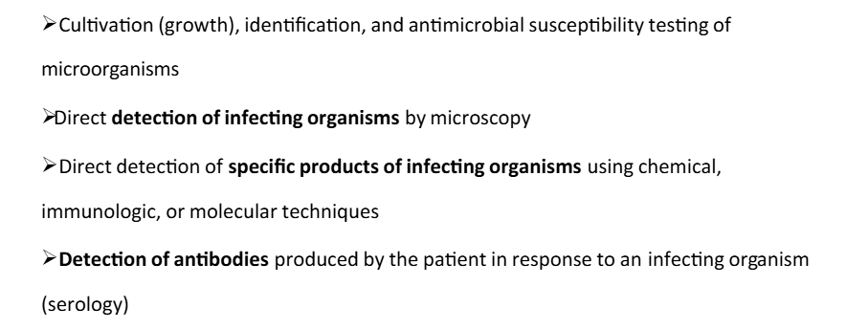

Slide 3
Addition
Chemical analysis: Collecting samples for chemical analysis.
Microbiological analysis: Collecting samples for microbiological analysis.
Scientific research: Collecting samples for scientific research.

Slide 4
Standard Precautions to prevent contamination of specimen and technician
• Always wash hands before and after the collection of specimens.
• Wear gloves when necessary.
• Disposal of needles, syringes and sharps must be into sharps containers.
• Always identify the patient.
• Select the right equipment required to collect the specimens (blood tubes, swabs etc.).
• Once the sample is collected, dispose of any sharp's objects immediately.

Slide 5

Never do mouth pipetting.
Barrier protection such as gloves, masks, goggles and apron must be available,
Must be change gloves and adequately dispose of them between drawing blood from different animals or patient.
Frequent hands washing whenever gloves are changed.

Slide 6
Facial barrier protection used for spattering of blood or body fluid.
7. Avoid using syringes whenever possible and
dispose of needle in white coloured container
Make a habit of keeping your hands away from your mouth, nose, eyes and other mucous membrane inoculation.

Slide 7
9. Decontaminate all surfaces and reusable device after use.
10.Before centrifuging tubes, inspect them for cracks.
12.Use biohazard disposal techniques. Eg. Red bag.
13.Never leave a discarded tube or infected material unlabeled.

Slide 8
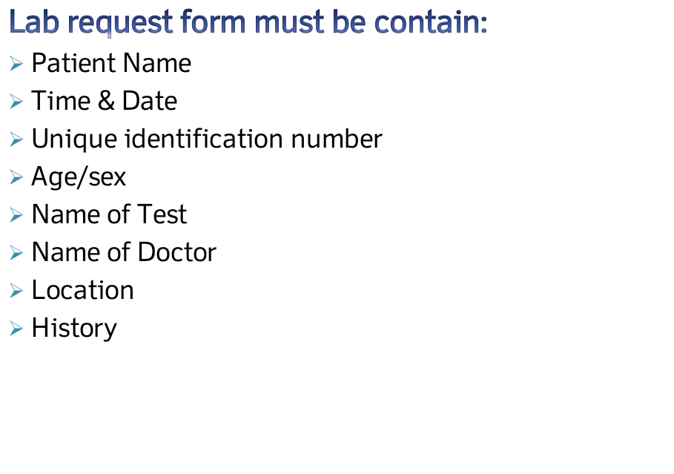

Slide 9
The preservation of microbial samples is crucial for maintaining their viability and genetic integrity over time
Each of these materials and methods has its advantages and is chosen based on the specific requirements of the microbial species being preserved.
1. **Cryoprotectants**: Substances like glycerol, dimethyl sulfoxide (DMSO), and trehalose are commonly used to protect cells during freezing. They help prevent ice crystal formation that can damage cellular structures.
2. **Lyophilization (Freeze-Drying)**: This process involves removing moisture from microbial samples, allowing them to be stored at room temperature. Protective agents such as sucrose or trehalose are often added to stabilize the cells during this process.

Slide 10
5. **Agar Slants**: For some bacteria, preservation on agar slants at 4°C can maintain viability for several months.
6. **Preservation Media**: Specialized media, such as nutrient broth or specific growth media supplemented with protective agents, can be used to maintain microbial samples during storage.
7. **Sealed Containers**: Using airtight containers or vials can help prevent contamination and desiccation of microbial samples during storage.
Saline, Antibiotic, antifungal, PBS.

Slide 11
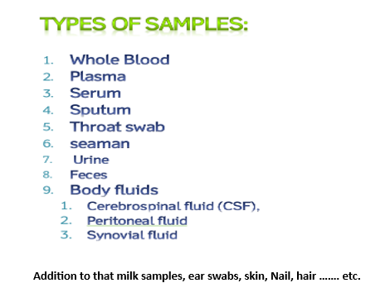

Slide 12
Stool samples: A 20% of fecal suspension prepared by collect about 1gm of feces + 4ml of saline put in special screw capped bottles. Shake the bottle by vortex and Then centrifuged 3500 rpm to obtain clear samples
Urine samples are collected as a (mid stream method). After washing the genitalia, leave the first and last drops of urine and collection done from mid stream by sterile container. Some time urine samples buffered by adding buffer solution.

Slide 13



Plasma Separating Tubes (PST)
Blood samples:
Fine system for blood sample collection is by the use of vaccum system, in which the blood sample is drown in to an evacuated tube. Blood must be always considered as a contagious material
Top Color | Additives | Principle | Uses
Lavender | EDTA Dose= 1to2g/l of blood | -The strongest anti-coagulant Ca⁺² chelating agent | Hematology Blood bank
Light Blue | Sodium Citrate 2g/l | Ca⁺² chelating agent | - PT - APTT:
Green | Sodium Heparin or Lithium Heparin | Heparin binds to Thrombin and inhibits the second step in the coagulation cascade (Prothrombin Thrombin) Fibrinogen Fibrin | Enzymes Hormones Electrolytes (Na⁺, K⁺, Mg⁺, Cl)
Heparin

Slide 14


Top Color | Additives | Principle | Uses
Gray | -Sodium Fluoride 2g/l -Potassium Oxalate | Glycolysis inhibitor Anti-Coagulant | Glucose tests
Serum Separating Tubes (SST)
Top Tubes | Additives | Principle | Uses
Red | ------ Sometimes it has gel or silicon at the bottom of tube to reduce hemolysis | Enhancing the formation of blood clot | Serology -Antibodies -Hormones -Drugs Virology Chemistry Blood cross matching before blood transfusion

Slide 15
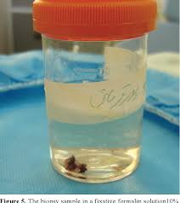
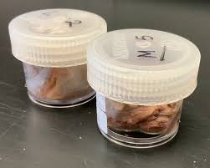
Tissue samples :Materials from patients are inoculated in to the tissue cultures to assay the pathogenic effect that caused by the microbial infection. Safety cabinet should be used to avoid the contamination of the tissues culture and prevent lab. Acquired infection

Slide 16
Milk sample collection from animals is an essential practice in the dairy industry to monitor the health and quality of milk produced. Here are some key steps involved in the collection of milk samples from animals:
1. **Preparation**: Ensure that all equipment used for sample collection, such as sterile containers and gloves, are clean and sanitized to prevent contamination.
2. **Animal Handling**: Approach the animals calmly to minimize stress. Proper handling techniques should be employed to ensure the safety of both the animals and the personnel involved in the collection process.
3. **Sample Collection**: Milk samples should be collected from the udder using a clean and sterile method. It is important to discard the first few streams of milk to avoid contamination from the teat.
4. **Storage**: Once collected, milk samples should be stored in refrigerated conditions to maintain their integrity and prevent spoilage. The samples should be kept at a temperature below 4°C (39°F).

Slide 17
5. **Labeling**: Each sample should be clearly labeled with relevant information such as the date, time, animal identification, and any other pertinent details to ensure traceability.
6. **Transportation**: Samples should be transported to the laboratory in insulated containers to maintain the required temperature and prevent degradation of the sample quality.
7. **Testing**: Upon arrival at the laboratory, the milk samples undergo various tests to assess factors such as bacterial count, somatic cell count, and other quality indicators to ensure they meet safety standards.
.

Slide 18
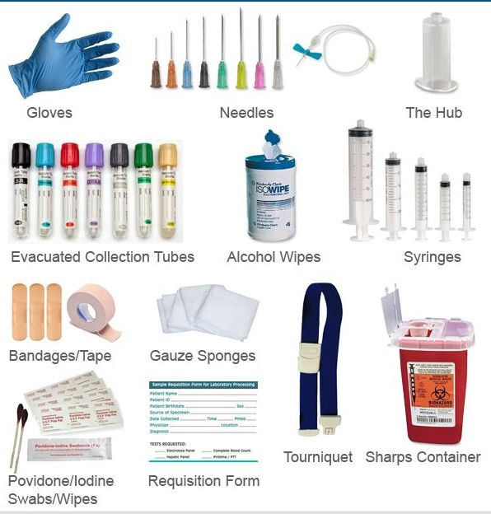
Phlebotomy

Slide 19
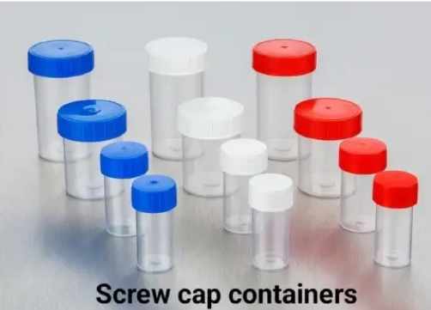
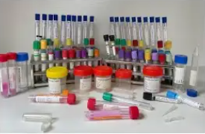
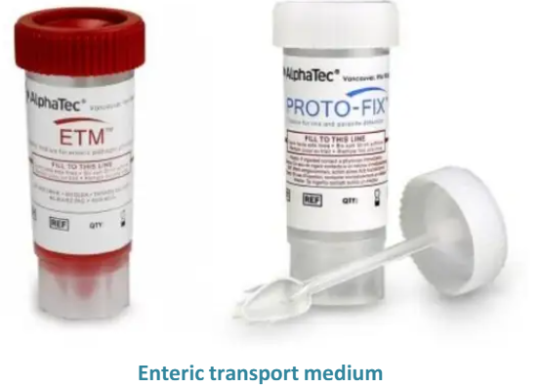
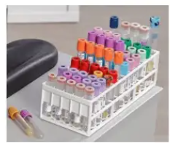
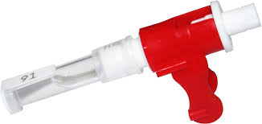
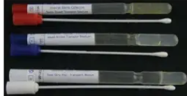

Slide 20
Types of sampling
1. Random sampling: Collect samples randomly from all over the site.
2. Systematic sampling: Collect samples regularly from all over the site.
3. Selective sampling: Collect samples selectively from sites or organisms
4. Stratified Sample**: The population is divided into subgroups (strata) based on shared characteristics, and samples are drawn from each stratum.

Slide 21
5. **Convenience Sample**: A sample taken from a group that is easily accessible, which may lead to bias but is often used for preliminary research.
6. **Cluster Sample**: The population is divided into clusters (often geographically), and entire clusters are randomly selected for the sample.
7 **Purposive Sample**: Also known as judgmental sampling, this involves selecting individuals based on specific characteristics or criteria relevant to the research.
8. **Snowball Sample**: A non-probability sampling technique where existing study subjects recruit future subjects from among their acquaintances.
9. **Voluntary Response Sample**: A sample consisting of individuals who choose to participate, often leading to self-selection bias.
Each type of sample has its advantages and disadvantages, and the choice of sampling method can significantly impact the results of a study.

Slide 22

Thank you

